Slide 1

Golden Threads
New Lace – Revolutionising the Travel Money Industry
Sponsored by
Dalian Neusoft University of Information, Dalian
The Australian Government, Canberra
The University of Queensland, Brisbane
Information Technologies, Mechanics and Optics University, Saint Petersburg

Slide 2

Our Team
Evan
Ethan
Will
Coen
Kevin
Alisa
Nikita

Slide 3

Our App

Slide 4
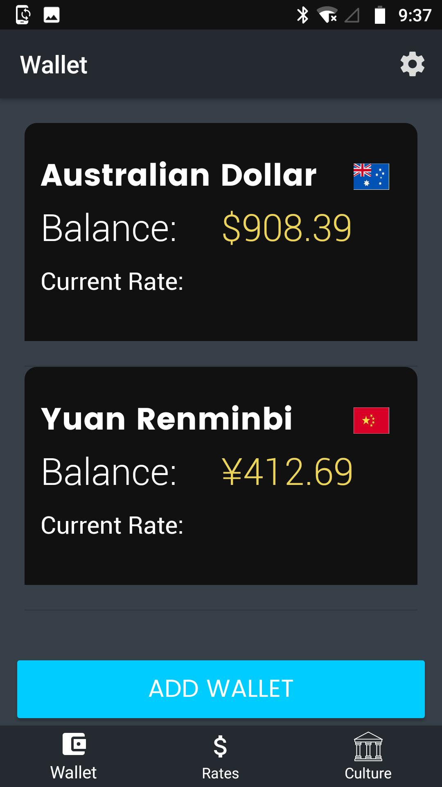
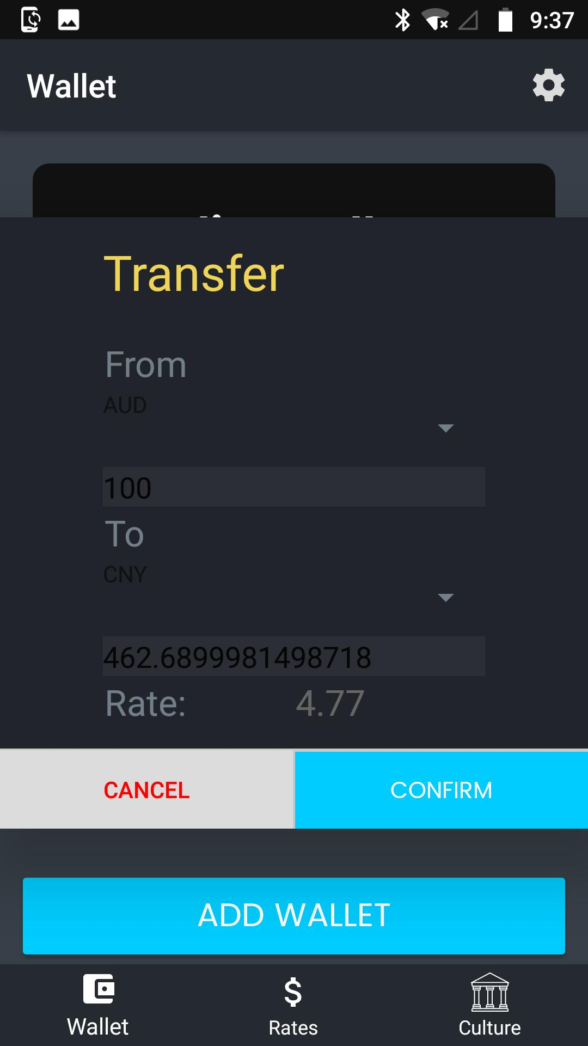
Walletech

Slide 5
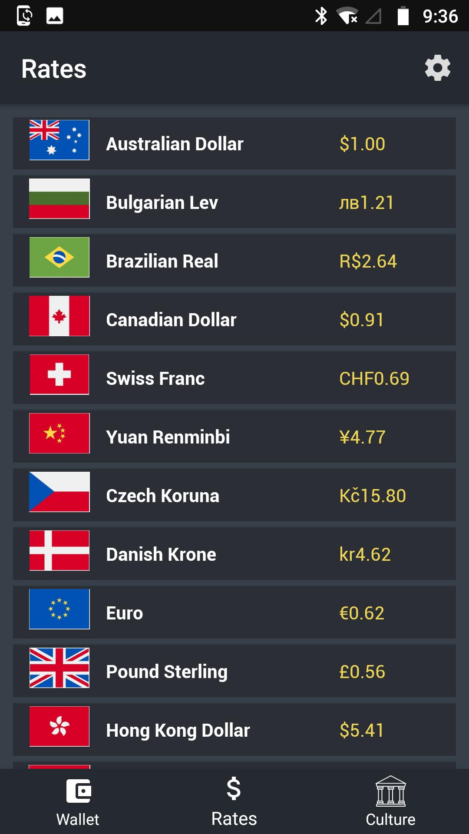
ERL Exchange Rate Lookup

Slide 6
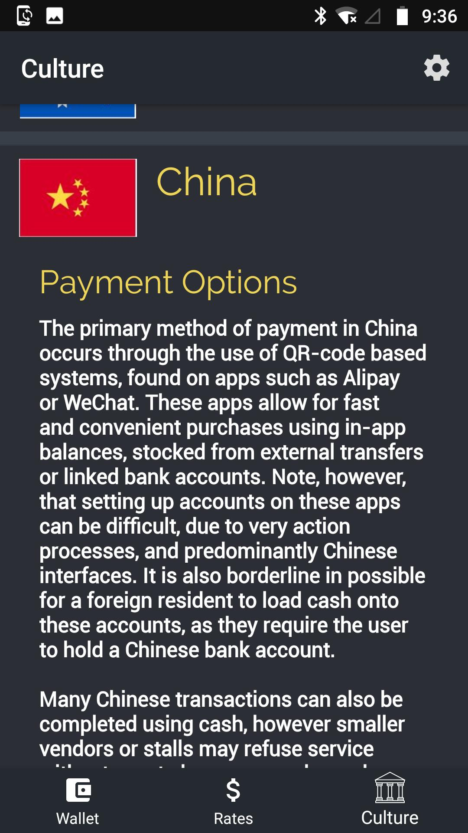
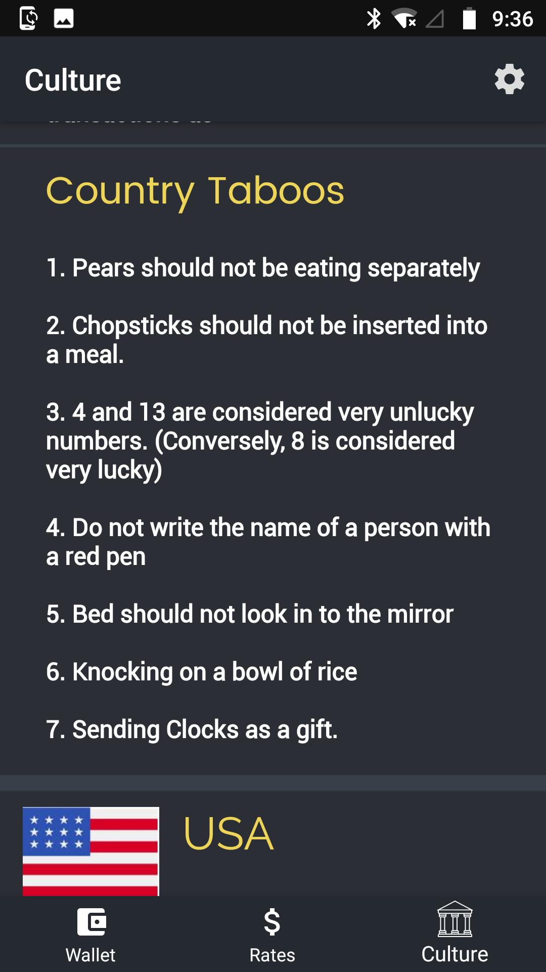
LCI Local Cultural Information

Slide 7
Demo

Slide 8
Issues and Risks

Slide 9
Our app was an internet based app,
but at times the internet was painfully slow

Slide 10
The makeup of our team
was not particularly strong

Slide 11
Reflection:
Time
More experience
More quality Java programmers

Slide 12
The Future

